Slide 1
Marginal productivity of wages
SUSHAN SHRESTHA

Slide 2
Meaning of wage
A wage is monetary compensation (or remuneration, personnel expenses) paid by an employer to an employee in exchange for work done.
Payment may be calculated as a fixed amount for each task completed (a task wage or piece rate), or at an hourly or daily rate, or based on an easily measured quantity of work done.
Wages are an example of expenses that are involved in running a business.

Slide 3
Types of wages
Money wages / nominal wages:
nominal wages refer to the amount of the wages measured in terms of money.
Real wages:
real wages refers to the purchasing power of money wages plus other allowances.

Slide 4
Marginal Productivity Theory
Propounded by J B Clark, A C Pigou, A Marshall, etc.
Marginal productivity theory of wage explains that under perfect competition a worker's wage is equal to marginal as well as average revenue productivity.
In other words marginal revenue productivity and average revenue productivity (ARP) of a worker determine his wages.
According to this theory wage of a laborer is determined by his marginal productivity.
This is also called marginal revenue productivity (MRP).

Slide 5
Continued…
MRP is the addition made to the total revenue by employing one more unit of a worker.
A producer will maximize his profit when the wage of a laborer is equal to the marginal revenue product. If MW is greater than MRP (MW > MRP) wage is greater than marginal revenue product. The producer will sustain loss then. If MW for labour is higher than its marginal revenue product then the employers get less and pay more. Thus he loses.
On the other hand if the producer pays wage less than MRP. (ME < MRP) he will gain. But his gain will not be maximized. Thus he will gain by employing workers so long when MW = MRP. Thus the wage of a laborer will be determined where MRP - M.W.

Slide 6
Continued…
The marginal productivity of labour is the ratio of the change in total productivity of labour with the change in units of labour
(i.e. MP_{L} =∆TP / ∆N )
Being a profit maximiser, the firm will hire more and more units of labour so long as the addition made to the productivity of additional labour is greater than the wage rate.
In this process the firm will reach an equilibrium (max profit point) where the marginal revenue productivity of labour just equal to marginal cost of labout (MC_{L}) .
The condition of equilibrium of a profit maximizer in the labour market is
VMPL = MC_{L} or VMP_{L} = W (i.e. MC_{L} = W)

Slide 7
Assumptions
Goal of firm is to maximize profit
Production technology remains constant
Economy operates at full employment in the long run
There is operation of law of diminishing marginal returns in the productivity of labour
There is single variable factor, labour, whose market is perfectly competative
Labourers are homogeneous and perfect with their mobility
Both employers and workers have perfect knowledge about the market wage rate

Slide 8
Schedule for marginal productivity of labour
L | Q_{X} | MP_{L} | P_{X} | VMP_{L} (MP_{L} . P_{X} ) | MC_{L} (Rs)
0 | 0 | - | - | - | 25
1 | 10 | 10 | 5 | 50 | 25
2 | 25 | 15 | 5 | 75 | 25
3 | 35 | 10 | 5 | 50 | 25
4 | 40 | 5 | 5 | 25 | 25
5 | 42 | 2 | 5 | 10 | 25

Slide 9
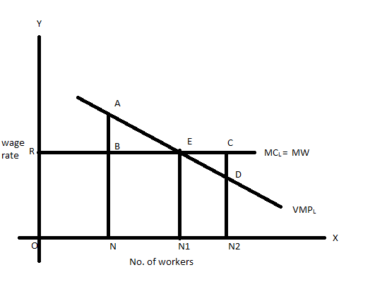
Wage rate determination

Slide 10
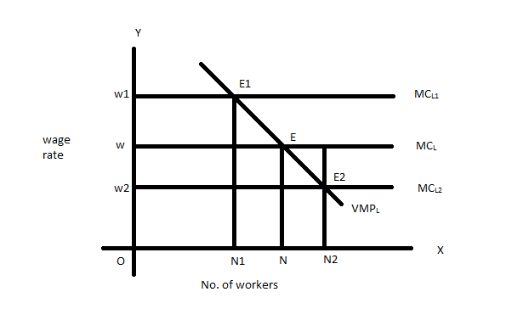

Slide 11
Criticisms
Unrealistic assumptions
Short period ignored
Difficulty in measuring marginal productivity
Collective bargaining power ignored
Ignores the supply side
Assumption of full employment
Ignores the wage differentials

